Slide 1
Robotics and IoT Club Secondary Years Level 2 - Week 8
Roohi Banu

Slide 2
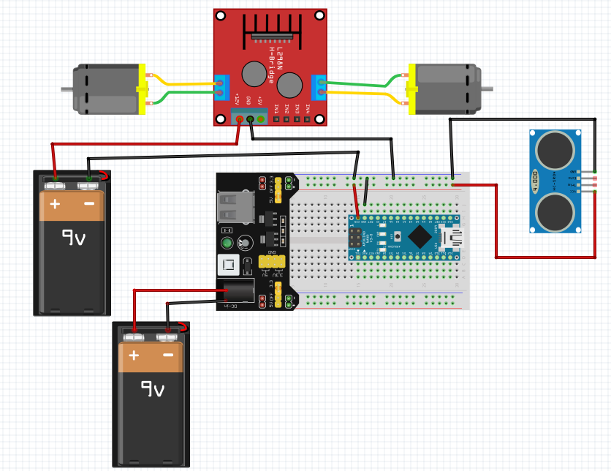
Power and Ground Connections

Slide 3
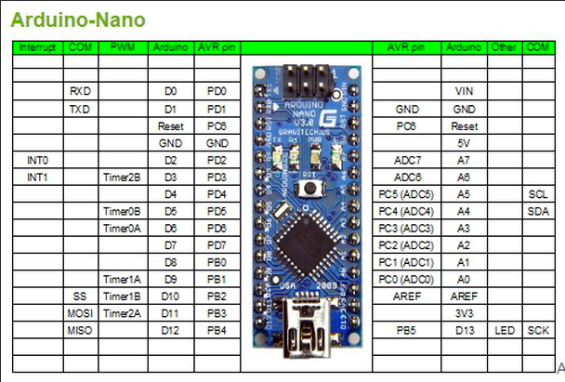
PWM Pins of Arduino

Slide 4
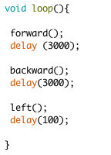
Algorithm - 1

Slide 5
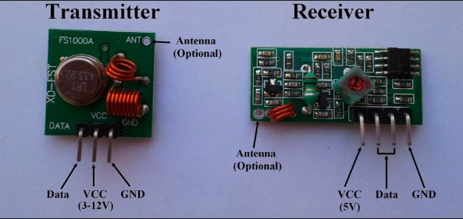
RF Communication
Radio Frequency Communication
It operates at a specific frequency of 433MHz.

Slide 6
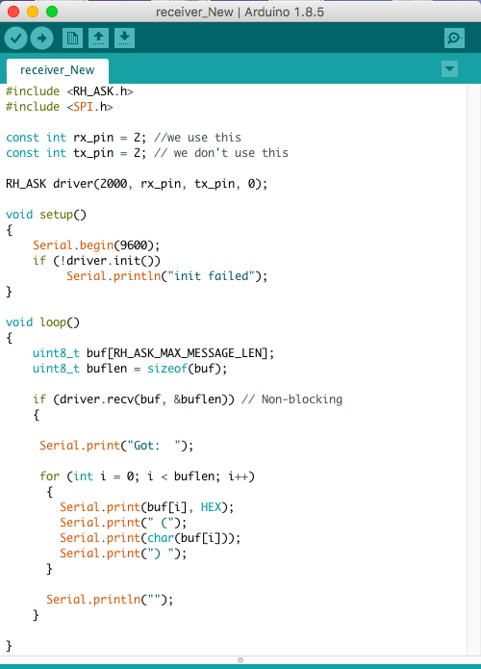
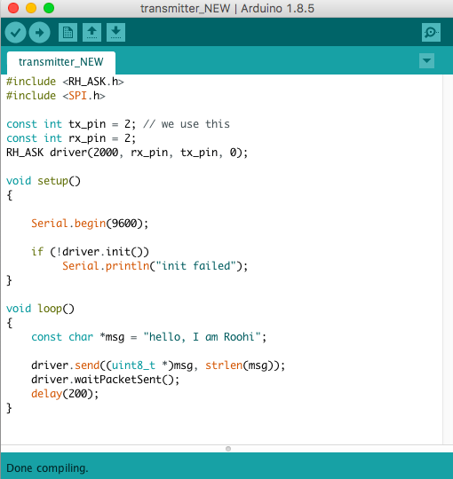
Arduino Code

Slide 7
How to Control Our Car Using ‘RF’
??

Slide 8
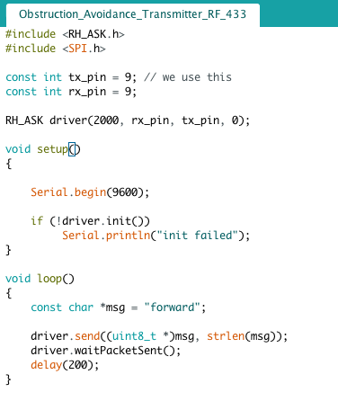
One way to control car
Does it work in ‘real time?’

Slide 9
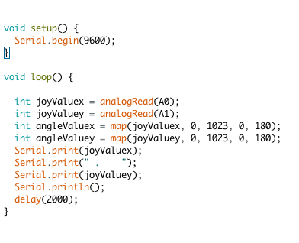
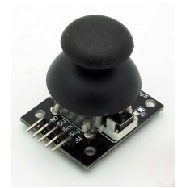
Joy Stick

Slide 10
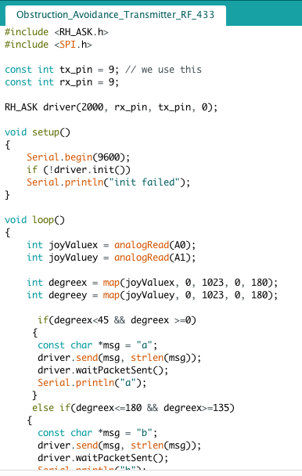
Use of Joystick to Control the Car- Tx

Slide 11
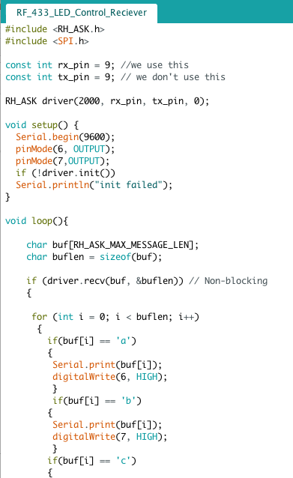
Use of Joystick to Control the Car - Rx

Slide 12
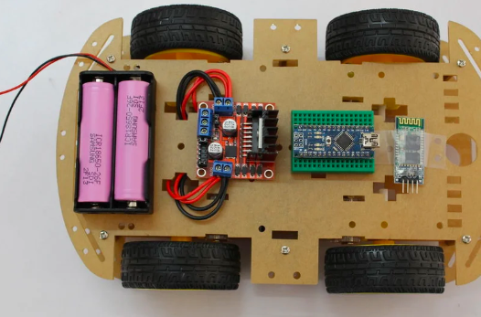
Battery Solution for Our Car
18650 Li-on Battery (2x)
18650 Battery Holder
Battery charger

Slide 13
Publications
Photon – TISB Publication for Physics & Technology -> Find info
EFY (Electronics For You) – efy.in –> Will send by End of October
efylab@efy.in
efyeditorial@efy.in
IET (Institution of Engineering & Technology) – theiet.in -> Getting the info
IEEE (Institute of Electrical and Electronics Engineers)
GitHub – Create an account – Start contributing

Slide 14
Projects & Reports
Sreshta – Bluetooth & voice controlled car (Android) + report
Ved – BLE (IoS) & autonomous car + report
Krish – IR controlled car + report
Sana – RF controlled car + report

Slide 15
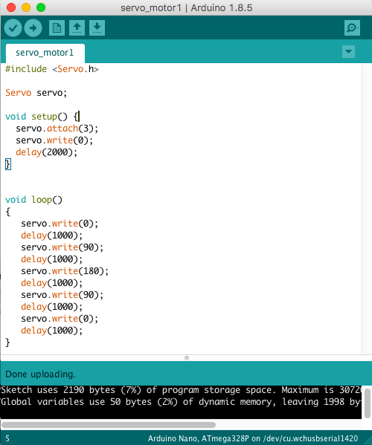
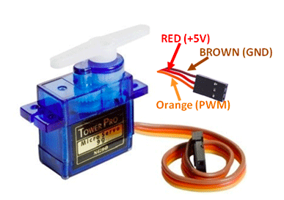
Servo Motor

